Slide 1
Week 3 Virtualization and Containerization
Dr Zhi Zhang

Slide 2
Overview
Operating System Concepts
Virtualization
Containerization

Slide 3
Operating System Concepts
Process scheduling
Virtual memory

Slide 4
What is a process?
A process is a program that is executed
It is a basic unit of execution in an OS.
At a minimum, process execution requires what kind of resources?

Slide 5
What is a process?
A process is a program that is executed
It is a basic unit of execution in an OS.
At a minimum, process execution requires CPU and memory without I/O devices.
Process scheduling (time-sharing)
Each process is scheduled and executed within their time share.
The number of processes can be much larger than that of the CPUs.

Slide 6
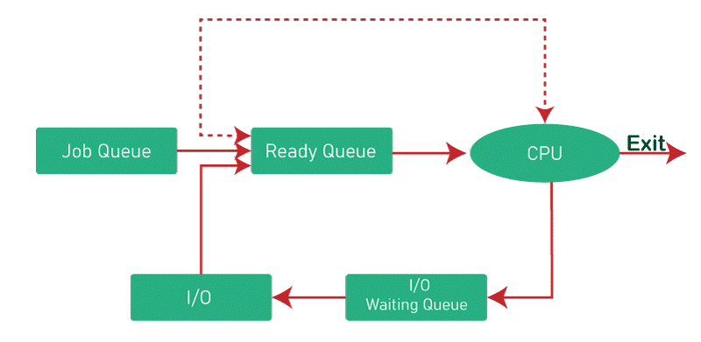
Process scheduling
https://www.tutorialandexample.com/process-scheduling-in-operating-system

Slide 7
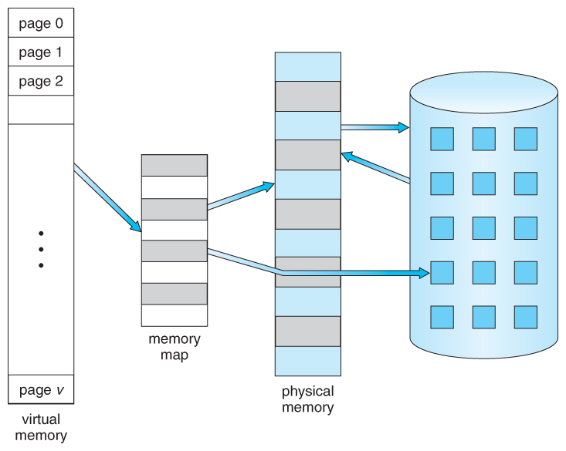
Virtual memory
https://www.cs.uic.edu/~jbell/CourseNotes/OperatingSystems/9_VirtualMemory.html

Slide 8
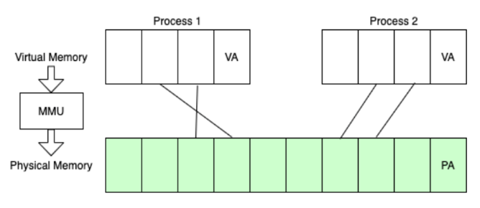
Virtual memory
Page table:
In a modern OS (e.g., Linux, Windows or MacOS), the OS uses a set of page tables to map virtual memory within a process to their corresponding physical memory in main memory.
VA refers to virtual address, pointing to a memory cell in a virtual page.
PA refers to physical address, pointing to a memory cell in a physical page.
https://www.alibabacloud.com/blog/a-tribute-to-hackers-the-way-to-explore-memory-virtualization_599058

Slide 9
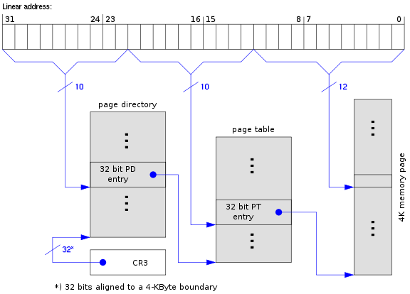
Virtual memory
Page table:
In a modern OS (e.g., Linux, Windows or OS X), the OS uses a set of page tables to map virtual memory within a process to their corresponding physical memory in main memory.
32-bit version of x86, known as IA-32 (Intel Architecture 32-bit), which supports a 32-bit memory address bus
memory cell
a set of page tables
https://www.cs.virginia.edu/~bjc8c/class/cs6456-s20/slides/01-intro.pptx

Slide 10
What is virtualization?
Virtualization is the ability to run multiple operating systems on a single physical system and share the underlying hardware resources [1]
Allows one computer software (called Virtual Machine Monitors or Hypervisor) to provide the appearance of many computers (called virtual machines).
Goals:
Provide flexibility for users
Amortize hardware costs
Isolate completely separate users
[1] VMWare white paper, Virtualization Overview

Slide 11
Characteristics for Virtualizable Computer Architectures
First, the VMM provides an environment for VM. The environment is essentially identical with the original machine.
Second, VM running in this environment shows minor decreases in speed.
Last, the VMM is in complete control of all system resources, such as CPUs, memory, disk, etc.

Slide 12
VMM Types
Hosted Architecture
Install as an application on existing x86 “host” OS, e.g. Windows, Linux, OS X
Leverage host I/O stack and resource management
Examples: ?
Bare-Metal/Native Architecture

Slide 13
VMM Types
Hosted Architecture
Install as an application on existing x86 “host” OS, e.g. Windows, Linux, OS X
Leverage host I/O stack and resource management
Examples: Virtualbox, VMware
Bare-Metal/Native Architecture
VMM or Hypervisor is installed directly on hardware
Acknowledged as preferred architecture for mainstream public clouds
Examples: KVM, Xen, Hyper-V

Slide 14
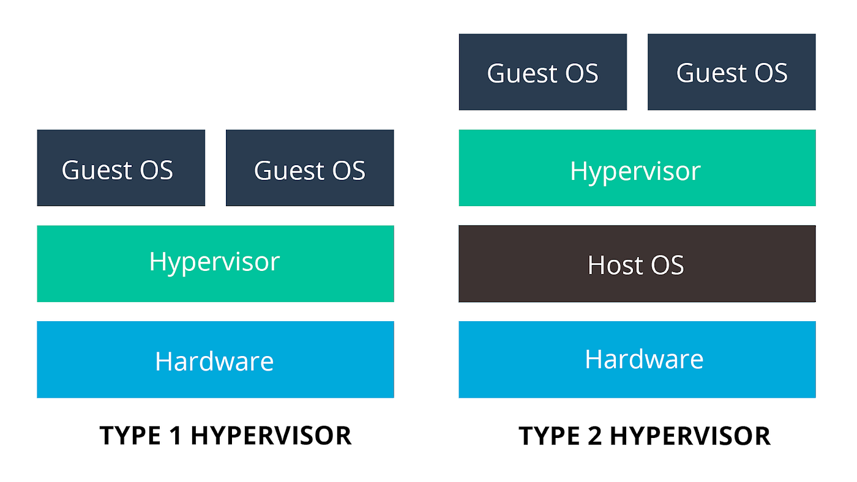
VMM Types
Native Architecture
Hosted Architecture

Slide 15
Virtualization: history
1960’s: first track of virtualization
Time and resource sharing on expensive computers
IBM VM/370
Late 1970s and early 1980s: became unpopular
Cheap hardware and multiprocessing OS

Slide 16
Virtualization: history
1960’s: first track of virtualization
Time and resource sharing on expensive computers
IBM VM/370
Late 1970s and early 1980s: became unpopular
Cheap hardware and multiprocessing OS
Late 1990s: became popular again
Wide variety of OS and hardware configurations (compatibility issue)
VMWare
Since 2000: hot and important
Cloud computing
Containers

Slide 17
Virtualization on x86 architecture
Solutions:
Full virtualization implemented by Dynamic binary translation & Two-stage translation
Para-virtualization (Xen)
Full virtualization implemented by Hardware extension

Slide 18
Dynamic Binary Translation
The entire program (e.g., ARM format) is translated into a binary of another architecture (e.g., x86 format).
The translation occurs on-the-fly during program execution.

Slide 19
Dynamic Binary Translation
Source Code
Target Code
vPC
mov ebx, eax
mov ebx, eax
start
cli
mov [CPU_IE], 0
and ebx, ~0xfff
and ebx, ~0xfff
mov ebx, cr3
mov [CO_ARG], ebx
sti
call HANDLE_CR3
ret
mov [CPU_IE], 1
test [CPU_IRQ], 1
jne
call HANDLE_INTS
jmp HANDLE_RET
Courtesy Scott Define VMware Inc

Slide 20
Dynamic Binary Translation
For sensitive/privileged instructions, trap-and-emulate is needed.
e.g., IBM VM/370: the first virtualized system

Slide 21
IBM VM/370: the first virtualized system
Conversational Monitor System
Specialized VM subsystem (e.g., RSCS)
Mainstream OS
(e.g., DOS)
Another copy of VM
Virtual machines
Hypervisor
Control Program (CP)
Hardware
CPU, memory, I/O Devices
https://www.cs.virginia.edu/~bjc8c/class/cs6456-s20/slides/01-intro.pptx

Slide 22
IBM VM/370
Virtualization technology: trap-and-emulate
Application
Normal
OS
Kernel
Privileged
https://www.cs.virginia.edu/~bjc8c/class/cs6456-s20/slides/01-intro.pptx

Slide 23
IBM VM/370
Virtualization technology: trap-and-emulate
Application
Guest OS
Normal
Kernel
Trap
Emulate
CP
Privileged
https://www.cs.virginia.edu/~bjc8c/class/cs6456-s20/slides/01-intro.pptx

Slide 24
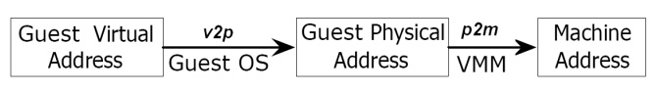
Two-stage translation
Guest page table:
A virtual machine has its own guest page table (GPT), managed by the guest OS. The GPT translates guest virtual addresses to guest physical addresses.
Shadow page table:
The hypervisor creates a shadow page table for each guest page table. The shadow page table translates guest virtual addresses to machine addresses.
Two-stage translation:
When a virtual machine running on the hypervisor performs a memory access, the virtual address goes through two stages of translation.

Slide 25
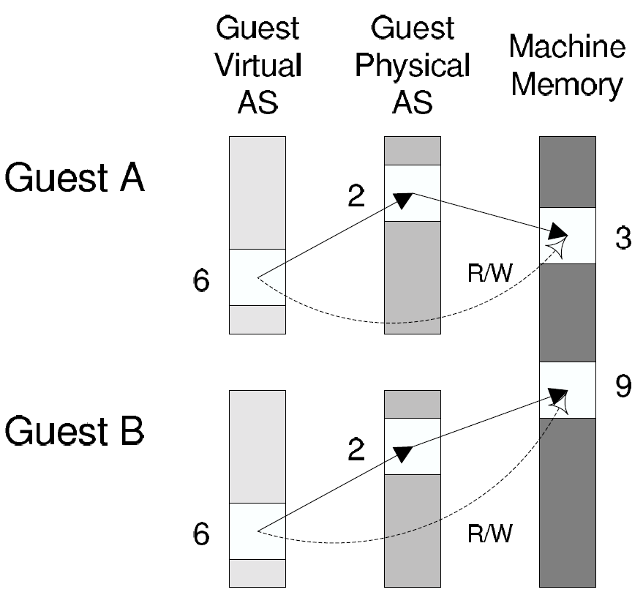
Two-stage translation
Guest page table
https://www.cs.virginia.edu/~bjc8c/class/cs6456-s20/slides/01-intro.pptx

Slide 26
Two-stage translation
Guest page table
Shadow page table
https://www.cs.virginia.edu/~bjc8c/class/cs6456-s20/slides/01-intro.pptx

Slide 27
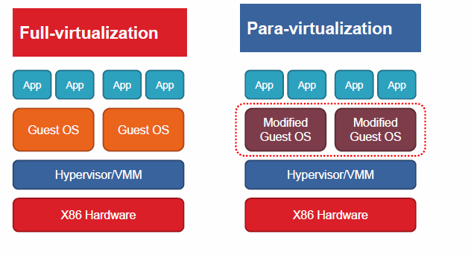
Para-virtualization
Full vs. Para virtualization
NO changes to OS but big overhead
Significant changes to OS but small overhead

Slide 28
A typical example: Xen
SOSP (ACM Symposium on Operating Systems Principles ) in 2003.
Very high impact (data collected in 2013 and 2023)
10218

Slide 29
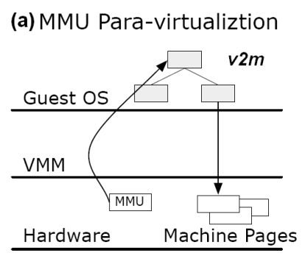
Overview of Xen
Modify guest OS to be aware of virtualization
No emulation of privileged operations from guest OS
Better performance

Slide 30
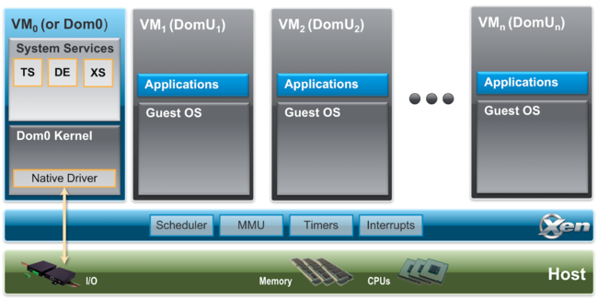
Xen architecture
TS is Toolstack, providing a user interface to the Xen hypervisor administrator.
DE is Device Emulation (DE), emulating devices when the devices are not available.
XS is XenStore/XenBus, managing information that are shared between some domains.
https://wiki.xenproject.org/wiki/Xen_Project_Software_Overview

Slide 31
A short conclusion
Full virtualization
Unmodified guest OS
Performance issue
Para virtualization:
Better performance
Modified guest OS

Slide 32
Support from hardware extensions
Full/Para virtualization: software-based virtualization
Hardware support: Intel and AMD assist virtualization

Slide 33
x86 Protection Rings (CPL)
CPU Privilege Level (CPL)
x86 has four protection levels (rings) /CPU privilege levels (CPLs).
ring 0 – “Kernel mode” (most privileged)
ring 3 – “User mode”
ring 1 & 2 – Other
Linux only uses ring 0 and ring 3.
“Kernel vs. user mode”
For previous full virtualization, guest OS applications run in ring 3, guest OS kernel runs in ring 1, and the hypervisor runs in ring 0.

Slide 34
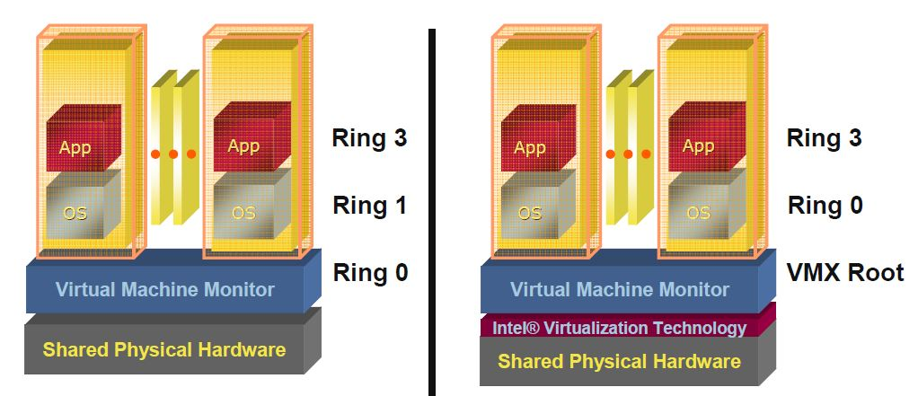
CPU virtualization: Intel VT-x & AMD SVM
Host mode
Guest mode
Ring3
Ring3
VM Entry
Ring2
Ring2
Guest mode
Ring1
VM EXIT
Ring1
Host mode
Ring0
Ring0
Software-based virtualization
Hardware-assisted virtualization

Slide 35
An example: Intel VT-x
Two VT-x operating modes
Less-privileged mode (guest or VMX non-root) for guest OSes
More-privileged mode (host or VMX root) for VMM
Two transitions
VM entry to non-root mode
VM exit to root mode
Virtual Machines (VMs)
Ring 3
Apps
Apps
Ring 0
OS
OS
VM Exit
VM Entry
VMX Root
VM Monitor (VMM)

Slide 36
CPU virtualization
New VM mode bit
Create two orthogonal modes
If VM mode bit is clear → host mode
If VM mode bit is set → guest mode
Benefits:
Eliminating the need of binary translation: significant performance improvement.
Requiring no changes to privileged operations in guest OSes: compatible with existing modern OSes.

Slide 37
Containers: concepts
A container is a sandboxed process running on a host OS that is isolated from all other processes running on that host OS [2]
A container image is a stand-alone and executable software package (e.g., dependencies, binaries, etc) that contains everything needed to run an application.
A container is a runnable instance of the image.
[2] https://docs.docker.com/get-started/

Slide 38

Containers
Container
VM
https://www.weave.works/blog/a-practical-guide-to-choosing-between-docker-containers-and-vms

Slide 39
Containerization vs. Virtualization
Granularity
Containers are an abstraction of the process layer and VMs are a simulation of the hardware layer.
Overhead
Required resources: containers are created to run one application and VMs support a whole OS.
Efficiency: containers are launched to run an application. VMs need to boot up an entire OS.
Security/Isolation
Containers are isolated from each other at the process level. VMs are isolated at the OS level.

Slide 40
Backbones of containers
namespaces
cgroups

Slide 41
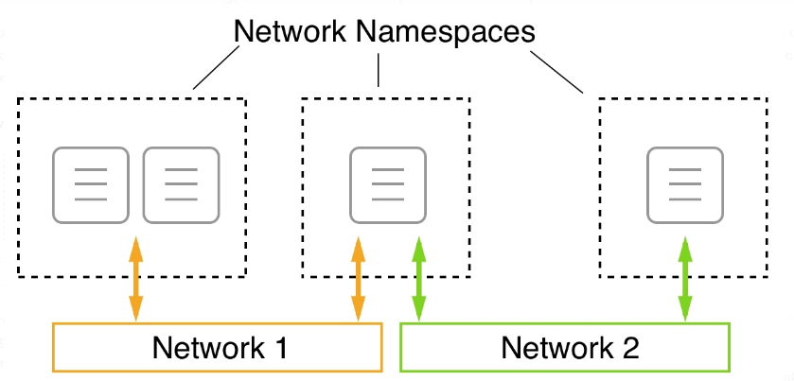
namespaces: limit what a container can see
Provide containers with their own view of system resources (e.g., network)
container
https://subscription.packtpub.com/book/cloud-and-networking/9781838827472/13/ch13lvl1sec97/running-in-an-existing-network-namespace

Slide 42
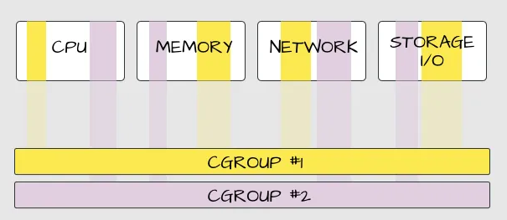
cgroups: limits how much a container can use
Control Groups: manage resource usage and limits for processes within a container.
Example: a container is limited to use only 1 Mbps of network bandwidth

Slide 43
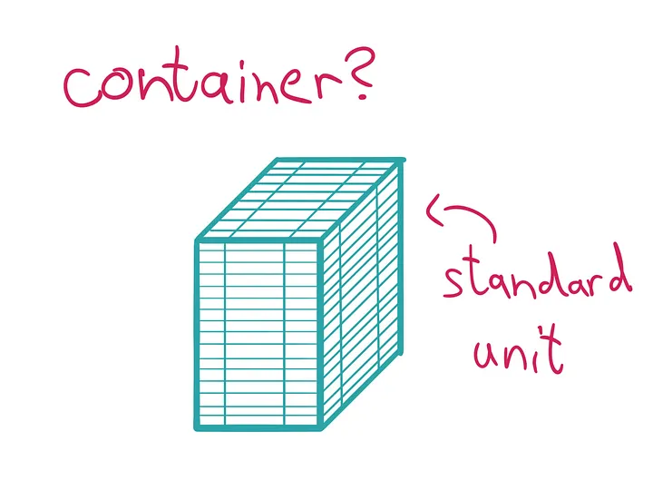
Docker container
Docker provides an interface on top of the techniques
Popularized containers (a standard unit of software)
https://medium.com/@saschagrunert/demystifying-containers-part-i-kernel-space-2c53d6979504

Slide 44
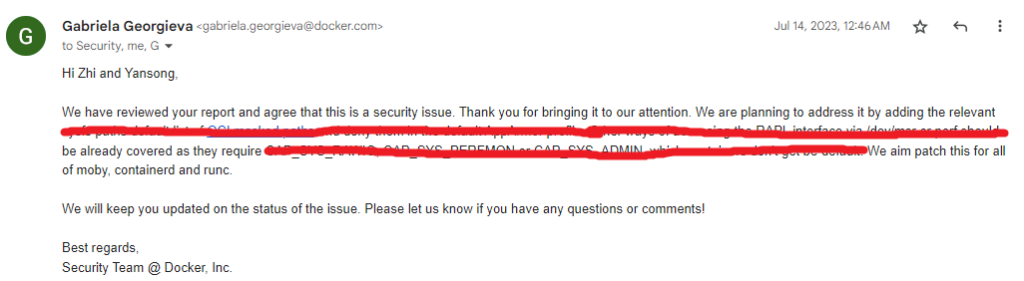
Docker container

Slide 45
Docker cheatsheet
docker run – Runs a command in a new container.
docker start – Starts one or more stopped containers
docker stop – Stops one or more running containers
docker build – Builds an image form a Docker file
docker pull – Pulls an image or a repository from a registry
docker push – Pushes an image or a repository to a registry
docker export – Exports a container’s filesystem as a tar archive
docker exec – Runs a command in a run-time container
docker search – Searches the Docker Hub for images
docker attach – Attaches to a running container
docker commit – Creates a new image from a container’s changes

Slide 46
Practice Questions
[7 marks] Q1: Describe what virtualization is and describe the characteristic attributes of the different types of virtualization (Language, Operating System and Hardware).

Slide 47
Practice Questions
[7 marks] Q1: Describe what virtualization is and describe the characteristic attributes of the different types of virtualization (Language, Operating System and Hardware).
[1 mark] Virtualization is a technology that allows multiple virtual instances of resources (e.g., operating systems) to run on a single physical machine.
[2 marks] Language virtualization:
[2 marks] Operating system virtualization:
[2 marks] Hardware virtualization:

Slide 48
Practice Questions
[7 marks] Q1: Describe what virtualization is and describe the characteristic attributes of the different types of virtualization (Language, Operating System and Hardware).
[1 mark] Virtualization is a technology that allows multiple virtual instances of resources (e.g., operating systems) to run on a single physical machine.
[2 marks] Language virtualization: provides a virtual runtime environment such as JVM that allows code written in a specific programming language such as Java to execute.
Cross-OS: code can be executed across different OSes without modification.
[2 marks] Operating system virtualization:
[2 marks] Hardware virtualization:

Slide 49
Practice Questions
[7 marks] Q1: Describe what virtualization is and describe the characteristic attributes of the different types of virtualization (Language, Operating System and Hardware).
[1 mark] Virtualization is a technology that allows multiple virtual instances of resources (e.g., operating systems) to run on a single physical machine.
[2 marks] Language virtualization: provides a virtual runtime environment (e.g., JVM) that allows code written in a specific programming language (e.g., Java) to execute.
Cross-OS: code can be executed in a virtual runtime environment across different OSes without modification.
[2 marks] Operating system virtualization: allows multiple user-space instances (e.g., docker containers) within a single operating-system kernel (e.g., Linux kernel).
Limited Isolation: instances share the host OS kernel, which means a vulnerability in the kernel could affect all instances.
[2 marks] Hardware virtualization:

Slide 50
Practice Questions
[7 marks] Q1: Describe what virtualization is and describe the characteristic attributes of the different types of virtualization (Language, Operating System and Hardware).
[1 mark] Virtualization is a technology that allows multiple virtual instances of resources (e.g., operating systems) to run on a single physical machine.
[2 marks] Language virtualization: provides a virtual runtime environment (e.g., JVM) that allows code written in a specific programming language (e.g., Java) to execute.
Cross-OS: code can be executed in a runtime environment across OSes without modification.
[2 marks] Operating system virtualization: allows multiple user-space instances (e.g., docker containers) within a single operating-system kernel (e.g., Linux kernel).
Limited Isolation: instances share the host OS kernel, which means a vulnerability in the kernel could affect all instances.
[2 marks] Hardware virtualization: creates multiple virtual machines sharing a single physical server.
VM Snapshots: allows saving the current state of a VM
Live VM Migration: enables moving runtime VMs between physical hosts seamlessly.

